Slide 1
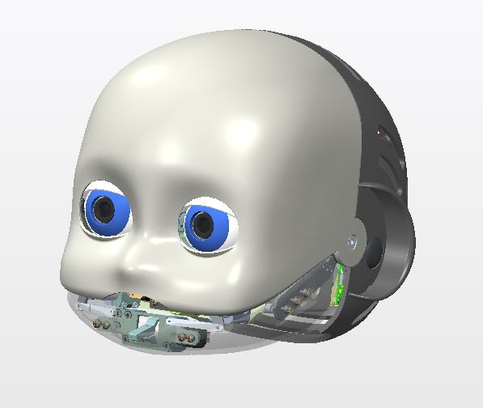
iCub3 Face joints specs
Rev. 0
10/11/2015

Slide 2
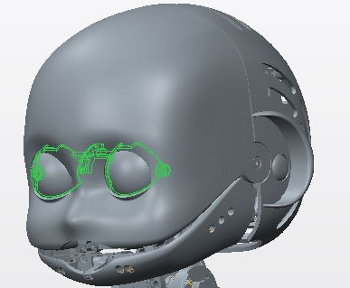
Eyelid
-Motor type: DC
-Motor encoder: 10 Lines per rev.
-Integrated gearbox 1/16
-AEA here
-Last stage reduction: 42/100
-HW limits (0° -70°)

Slide 3
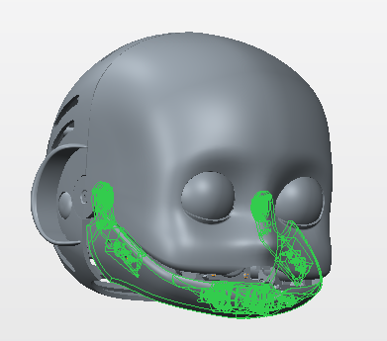
Jaw
-Motor type: DC
-Motor encoder: No
-Integrated gearbox 1/84
-AEA here
-Last stage reduction: 42/100
-HW limits (0° - 10°)

Slide 4
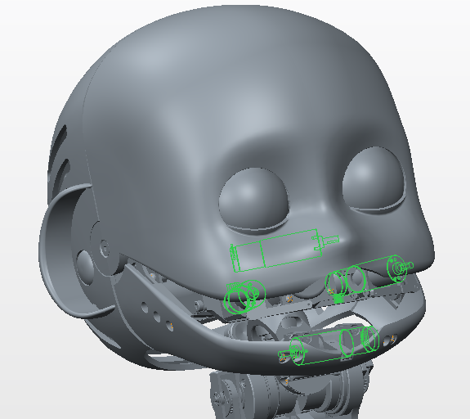
Lips
-Motor type: 4 DC motors
-Motor encoder: 400 ppr
- Integrated gearbox : 1/66
-No AEA
-HW limits n.a.

